Slide 1

First steps towards trentu life
Notes:
Cole: Slide 1 First steps at Trent
1: Introduce group members
“Hello everyone, I’m Cole and my group members are Rachit, Punyaja and Aymaan. Together we built First Steps At Trent.”
2: Brief outline of the project
“What is First Steps at Trent”? It is a simple webpage for new or future Trent international students, with a list of steps to it (nothing too complicated). The homepage features a descending list of steps giving you an overview of goals (or deliverables) that a new student would take to have a smooth transition coming to Trent. They can then click on what step they are currently working on and they will be brought to a new page outlining the information for completing that step. The header bar would feature a list of relevant links such as FAQs. On the right hand side would be a navigation bar featuring the steps from homepage to homepage. And that was about it, nothing too complicated, something doable in 8 weeks and if we had extra time (university students don’t have extra time) we could implement some of our nice to have goals like a list of reviews for the course or some course planning tools.“

Slide 2
WHY ?
Notes:
Rachit:
Why did we decide to build this product? Most of us are international students and we experience first hand the mess that can be made if not guided properly. What do I mean by that?
(Next slide)
And you know what Trent International agrees
When we met Paul longhust for TRent International he liked the idea and agreed that having a tool like this woild tu

Slide 3
How badly can you mess up ?
Don't know about registering courses
Don't know how credit works
Don't know what are your limitations for working On & Off-campus
Dont know who to reach out if you mess up somewhere
Make best use of the resources
Notes:
Rachit:
How badly can we mess up? There are some BIG mistakes or steps as we call in the product that if we mis, then its a very rocky and stressful start - speaking from experience. To avoid such mistakes we wanted to create a ONE STOP page with all steps in order for the new international students

Slide 4
Key Issues/ChalLenges Dealt
Notes:
Aymaan:
There were a few key issues and challenges we faced during our project timeline

Slide 5
Communication
Have a rich path of communication
Utilize services like instagram and zoom
Consistent and frequent Team and Client Meetings
Scrum report and Kanboard helped to know progress of each part.
Notes:
Aymaan:
The biggest challenge was “communication”. We were unable to get in contact with each other for almost 2 weeks. So one day after class we all decided to stay a few minutes and decide on ways to have better communication.
We decided to utilize services like instagram to be in constant communication
We decided to use zoom to meet and have consistent team meetings and meetings with clients
And our consistency with scrum reports and kanboard tickets kept us all in the loop

Slide 6
Research
Unaware of all steps and information in order
Not knowing the standards of coding and brand guidelines that Trent University follows
Webpage content to match client’s expectations
Notes:
Punyaja:
As we mentioned, our goal was to create a product that wll hold hands for new international students and provide them with all necessary information. Therefore, Research was an important part for our project’s success. Any wrong information or information in wrong order would lead to a failure due to negligence from our side.
Therefore we met with our client and ensured to get all requirements such as brand guidelines Trent U follows, and also the steps, info and content to be added on all the pages.
There were challenges when we missed some info or were confused of some steps, but the regular client meetings helped us overcome that challenge.

Slide 7
Task interdependencies
We felt that some tasks could result in some delays to the project as they were dependent on other task completion
To avoid such delays, we changed our tasks execution of order a bit by prioritizing development (features) first, followed by testing (within the same sprint)
Notes:
Cole:
Tasks such as testing a feature depends entirely on the “development” of the feature. We can’t test until we have development done, of course.
So we just modified our order of execution of the tasks so that everyone first finished their development and then we all proceeded with testing. This way there were no chances of delays or idle time for anyone (where someone was waiting for another person to finish there piece of the project). This ensured that in the latter half of our sprint, we had a full week to test the features (at worst) and more than a week (at best). As such, all deliverables were completed on time and properly tested.

Slide 8
Proceed to product demo
Notes:
Punyaja:
Switch to the Website Demo
Everyone talks about their own features? This might take time..
One person can go over the entire website and talk about the design of the UX rather than content. I can do that,
just show homepage - show all steps, design, header, footer
Go to step 1 - show all features of the webpage like the side nav bar, the links on top
Similarly then just go over all the steps just mentioning the “STEP name” and that’s it
This should be like an overview and take like 3-4 minutes MAX

Slide 9
Lessons learned
Notes:
Rachit:
Moving onto lessons learned by us

Slide 10
Key lessons learned
A successful project requires efficient Communication. Some forms of communications are not very efficient such as Emails. It is important to figure out the right kind of communication channel for your team
Proper research is required to avoid big mess ups at the end
Consistent Team meetings are important for the team to be on track and for all members to be updated
Consistent Client meetings are important for getting proper feedback to avoid big changes that may cause delays to deliverables
Notes:
Rachit:
Our key lessons learned are in parallel to the challenges we faced and more
Communication - we had a very rocky start and it was a little concerning on how we would be able to deliver our product. So we learned choosing an efficient communication channel is important
Proper research is required because users are going to rely on our product. Inadequate or wrong information, well, is never good
Consistent team meetings, as we learned in scrum, are very important and effective. It keeps everyone involved in the project in loop at all times
Consistent client meetings is important fo feedback to ensure our deliverables are as expected and any late feedback will ultimately delay the project

Slide 11
What we would do differently
Decide on a Communication Channel
Adequate Team Meetings from the start
Better Division of Work dependent on Strengths and Schedules
Notes:
Aymaan:
We would decide a proper communication channel that suits everyone on the beginning and not rely on emails
Start hosting Team Meetings a little earlier so that there are ADEQUATE Team meetings in every planning phase starting from first sprint
Divide our work among ourselves after a discussion of strengths and schedules as well, so as to avoid issues like task taking too long ot complete or task interdependencies

Slide 12
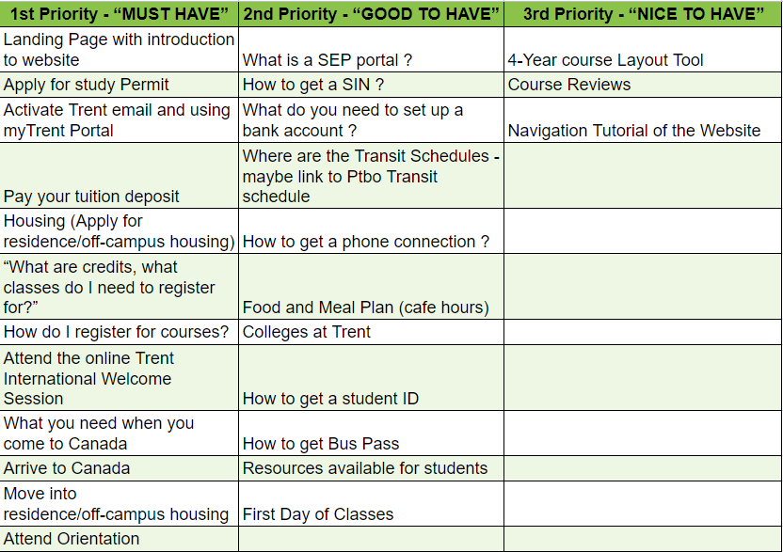
Features
Notes:
Punyaja: Well we wanted to add a lot more things to this site and some features that were really excited for.
As we were bound by the time of 8 weeks we weren't able to work on a lot of things. But Trent International is taking the project and it needs some refining and hopefully our website will be live and active the trent domin

Slide 13
THANK YOU!

